Slide 1
Reducing the orthopedic risk of cycling with a vision-based scanner
Project Management and software development
Final Presentation 15.07.2015
Mahdi Saleh
Supervisor : Benjamin Busam

Slide 2
Problem Statement
Fitting a bike to the costumer based on pose estimation

Slide 3
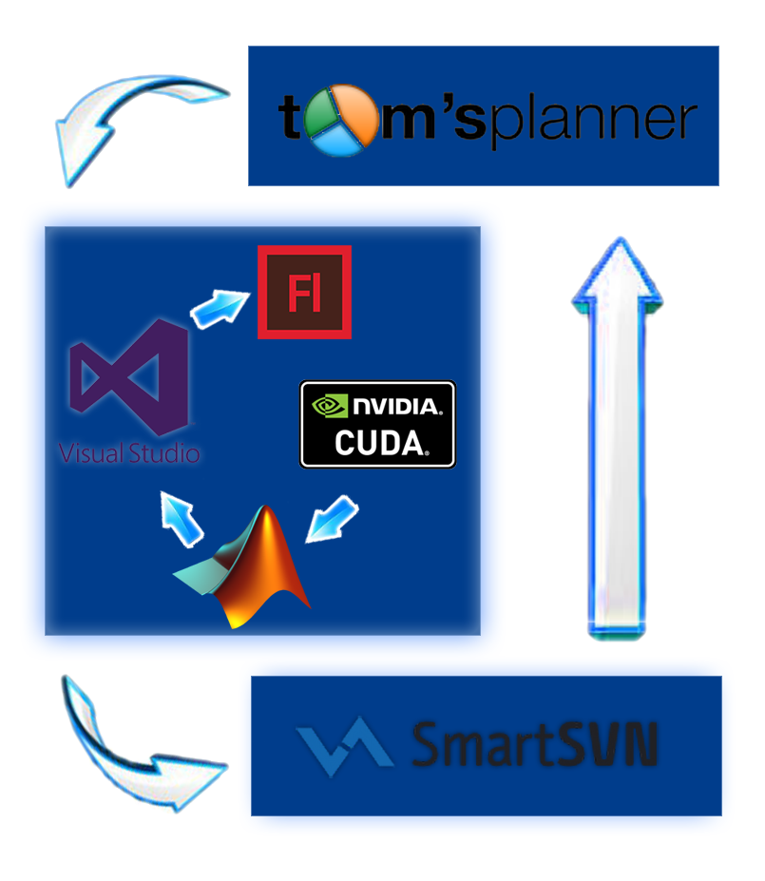
Software Requirements

Slide 4
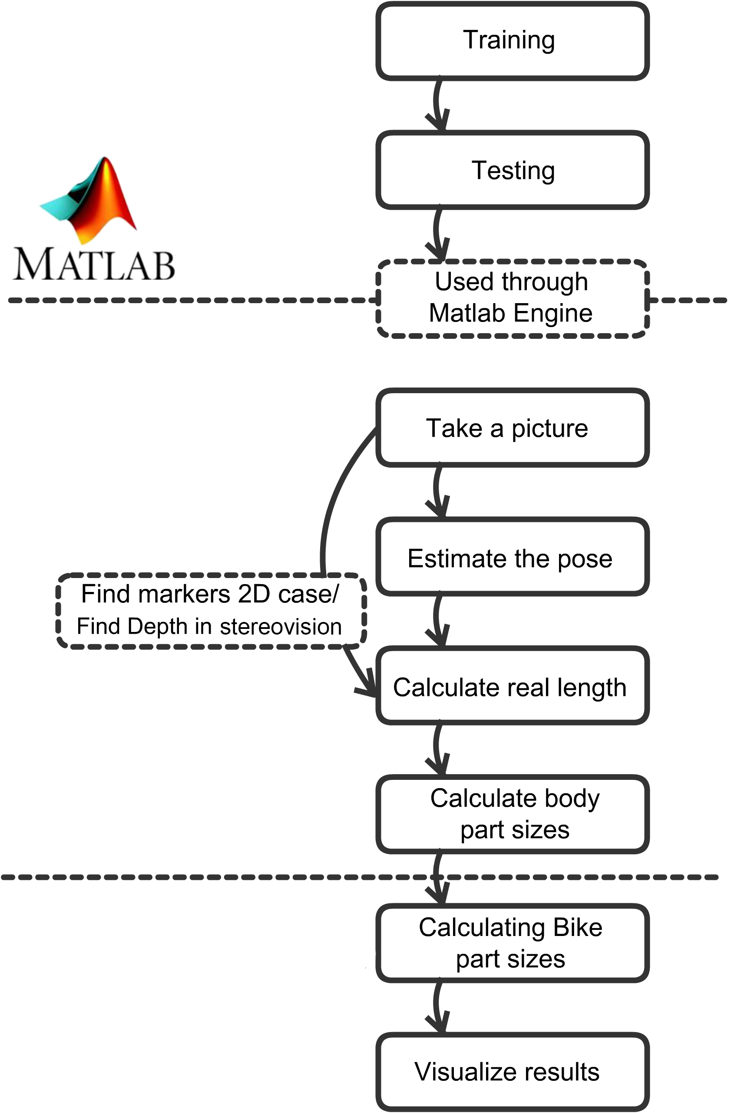
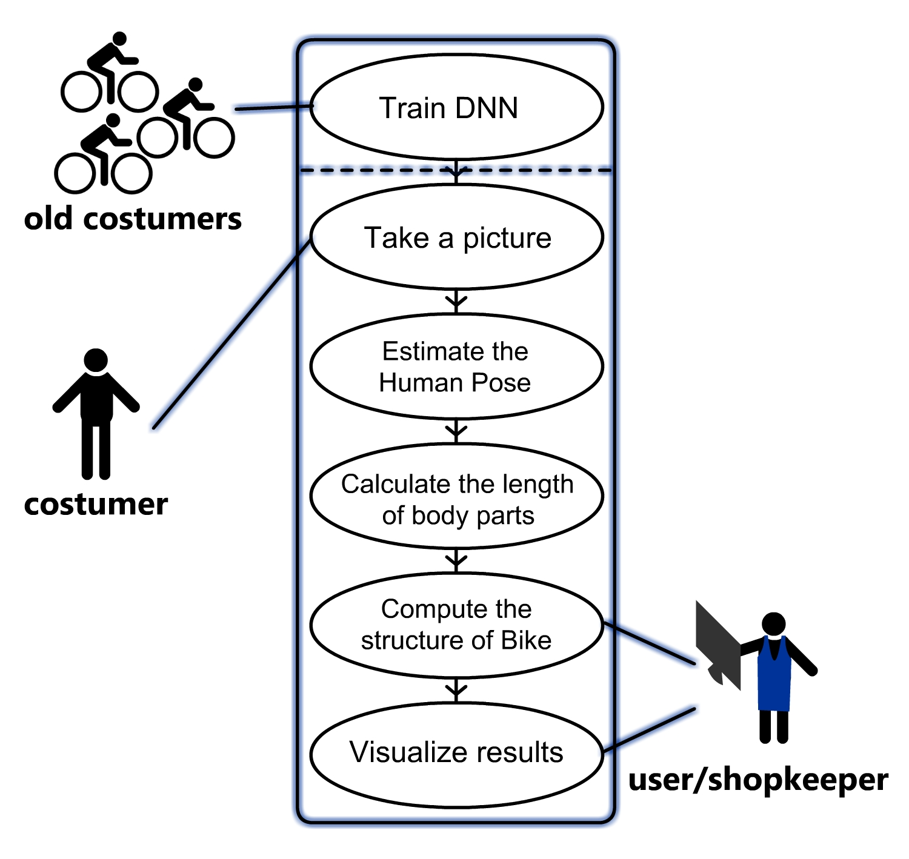
Procedure breakdown

Slide 5
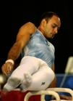
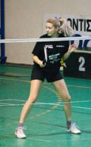
Offline Phase
Implemented in Matlab using MatConvNet
Convolutional Neural Network
Toshev, Szegedy ,cs.CV 2014, DeepPose: Human Pose Estimation via Deep Neural Networks
Used later through Matlab Engine
Leeds Sports Pose Dataset

Slide 6
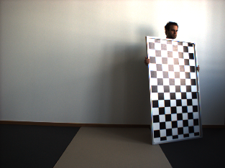
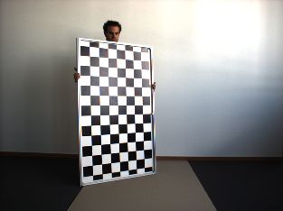
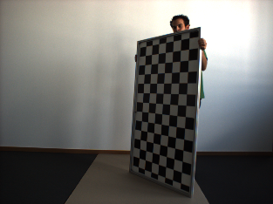
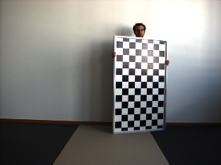
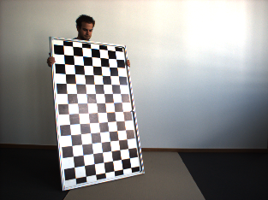
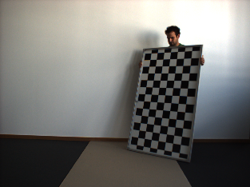
Computer vision tasks
Camera Calibration
Tens of images with checkerboard
Intrinsic Camera Parameters calculated and stored

Slide 7
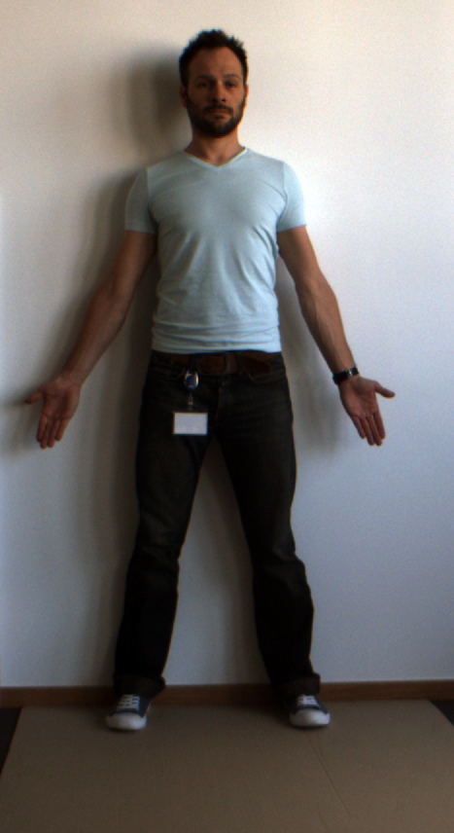
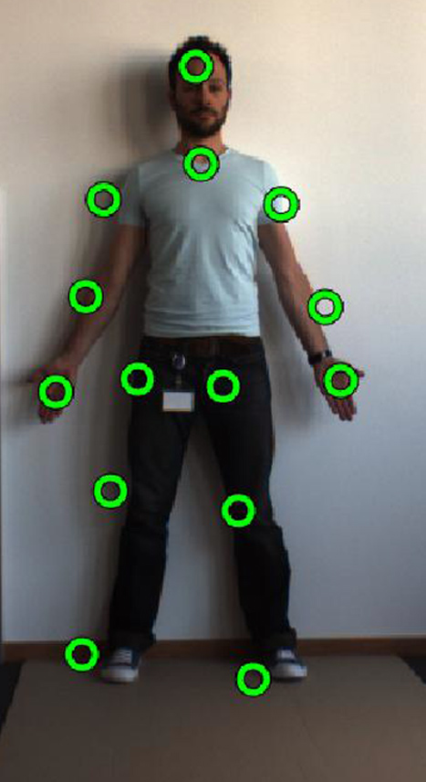
Computer vision tasks
Pose estimation
Human region is cropped
CNN validation
14*2 outputs extracted and drawn

Slide 8
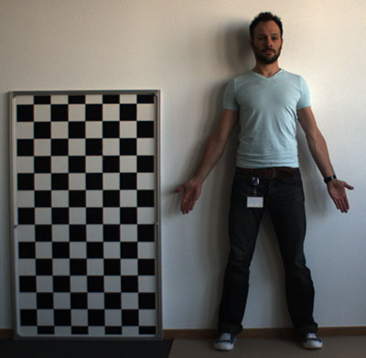
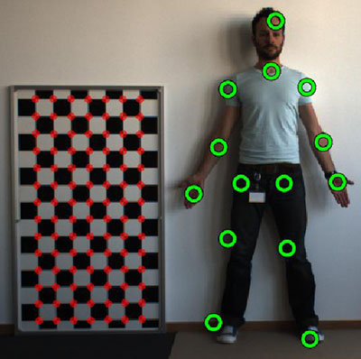
Computer vision tasks
Real pose estimation
Checkerboard detected
10cm x 10cm Patches - 8 x 13 Patches
Calculation in relation to checkerboard size

Slide 9
Bicycle relevant tasks
Human body parameters extracted
Bicycle parameters calculated
Formulas
Tables
VL
B
A
OR
R
RH
SH
K
S
KL

Slide 10
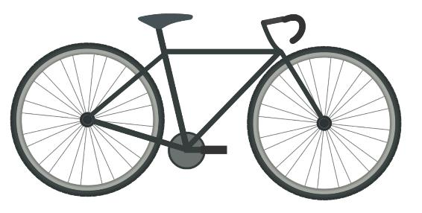
Bicycle relevant tasks
VL
B
OR
R
A
RH
SH
K
S
KL
$$SH=R∗0.885$$
$$OR=\left(R+A\right)∗H−A$$
Roadbike.de magazine, 10, 2012

Slide 11
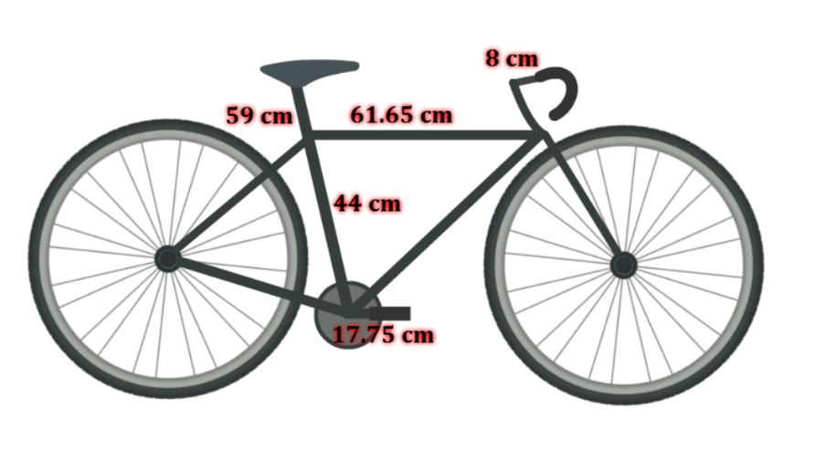
Visualization
Vector based
Coded with action script 3.0
Loaded as HTML file in GUI

Slide 12
Gantt chart
Initially proposed Gantt chart:
Final Gantt chart

Slide 13
Demo Presentation

Slide 14
Project Outlook
Improving Pose estimation in term of accuracy
Minor bug fixes
Video input
Dynamic Bicycle Fitting

Slide 15
Project Retrospective
Costumer’s Feedback
Lessons learned
Deep Learning in action
Connecting different parts
Time management
Work presentation

Slide 16
Thank you for your attention!

